Slide 1
PIZZA CAFE CHATBOT
Rushikesh Kedari (35)
Abhishek Kshatriya (42)
Prayas More (48)
Date of presentation: 07/11/2020
Under the guidance of: Prof.Poorna Pimpale
Atharva College of Engineering
Department of Information Technology

Slide 2
Content
1. Introduction
1.1 Introduction
1.2 Problem Statement
1.3 Proposed Solution
2. Literature Survey
2.1 Survey of Existing system
2.2 Limitation Existing system or research gap
2.3 Mini Project contribution
3. Proposed System
3.1 Architecture/Framework
3.2 Process Design
3.3 Software Requirement Specification
3.5 Output Screenshots
4. Conclusion
5. Future work
References
ACE- IT department Project Title: Pizza Cafe Chatbot

Slide 3
Introduction
A chatbots aims to make a conversation between both human and machine. The machine has been embedded knowledge to identify the sentences and making a decision itself as a response to answer a question.
Pizza Cafe Chatbot project will answer to customer's questions that are related to cafe services.
First bot analyzes customer’s queries and understands the customer’s message, based on bot knowledge bot provides answers to the queries of the customer.
Customers can ask questions related to food, location details, etc.
This bot will help you to find out the pizza prices and home delivery information and other queries etc.
ACE- IT department Project Title: Pizza Cafe Chatbot

Slide 4
Problem definition & Proposed solution
Problem Statement:
To create a highly efficient chatbot that will act as a virtual assistant to help customers with certain information about ordering their favourite pizza.
Proposed Solution:
A Pizza Cafe Chat Bots project is built using artificial algorithms that analyzes customer’s queries and understand customer’s message. This System is a web application which provides answers to the query of the customer very effectively. Customers just have to query through the bot which is used for chatting.
ACE - IT department Project Title: Pizza Cafe Chatbot

Slide 5
Review of literature
Name of the paper | Authors | Year | Description
PizzaPal: Conversational Pizza Ordering using a High-Density Conversational AI Platform | Antoine Raux, Yi Ma, Paul Yang, and Felicia Wong | 2018 | This paper describes PizzaPal, a voice-only agent for ordering pizza, as well as the Conversational AI architecture built at b4.ai. Based on the principles of high-density conversational AI, it supports natural and flexible interactions through neural conversational language understanding, robust dialog state tracking, and hierarchical task decomposition
Chatbot usage in restaurant takeout orders: A comparison study of three ordering methods | X.Y. Leung, H. Wen | 2020 | The purpose of this study was to explore customers’ perceptions and behaviors when using chatbots in restaurant takeout orders. Built on the social presence theory, this study conducted a lab experiment to examine and compare three ordering methods in quick-service and full-service restaurants
ACE- IT department Project Title: Pizza Cafe Chatbot

Slide 6
System description
A chatbot is a computer program that simulates human conversation through voice commands or text chats or both.
Chatbot, short for chatterbot, is an Artificial Intelligence(AI) feature that can be embedded and used through any major messaging applications.
ACE IT department Project Title: Pizza Cafe Chatbot

Slide 7
Hardware & software requirements
  Software Requirements:
    Python and required libraries
    Visual Studio Code
  Hardware Requirements:
    2 GB Ram and 500GB Hard Disk
    Modem, WAN-LAN, Ethernet Cross-Cable
    Screen Resolution: 800X600
ACE - IT department Project Title: Pizza Cafe Chatbot

Slide 8
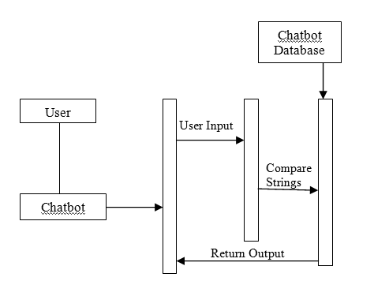
UML Diagram:
UML Diagram
ACE- IT department Project Title: Pizza Cafe Chatbot

Slide 9
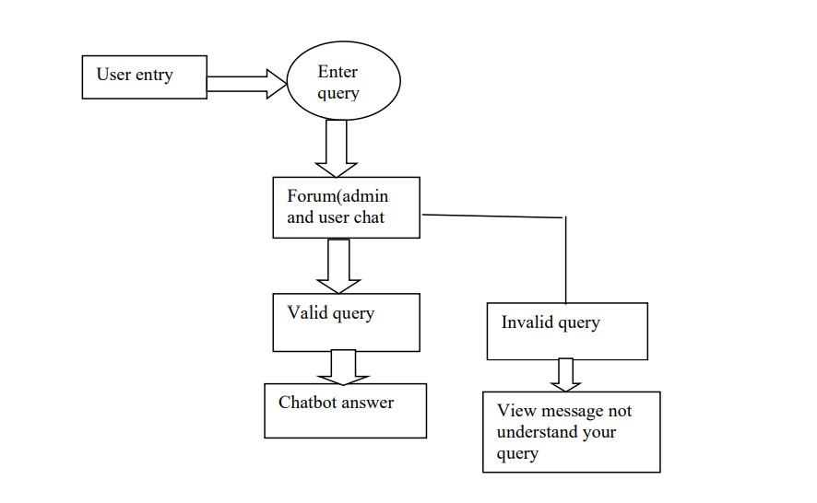
Methedology
ACE- IT department Project Title: Pizza Cafe Chatbot

Slide 10
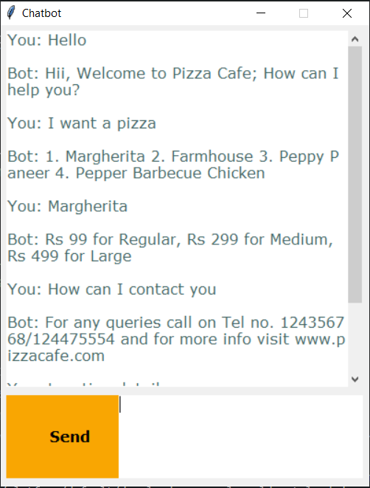
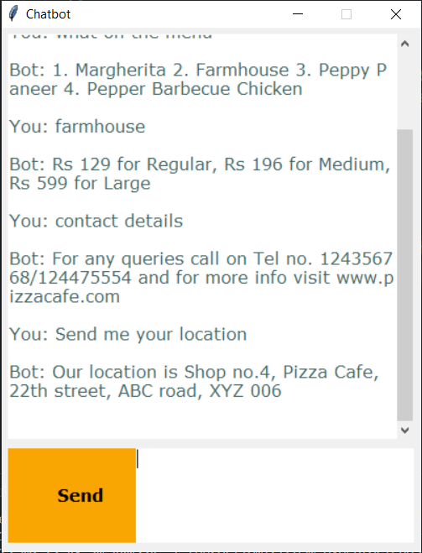
OUTPUT:
ACE- IT department Project Title: Pizza Cafe Chatbot

Slide 11
Conclusions
We have created a working Chat Bot using Deep Learning Library NLTK(Natural Language Processing Toolkit) with Keras and using python programming language. The Chat Bot replies to user text with high accuracy.
ACE- IT department Project Title: Pizza Cafe Chatbot

Slide 12
Scope of project
The system analyzes the question and then answers the customer. This project makes it easy to understand cafe services, food, location of cafe etc.
The customer does not have to personally go to the cafe for enquiry. This system provides stateful and user friendly service.
ACE IT department Project Title: Pizza Cafe Chatbot

Slide 13
Questions??
Thank You!
ACE- IT department Project Title: Pizza Cafe Chatbot

